Slide 1
Need finding for the Spelling game

Slide 2
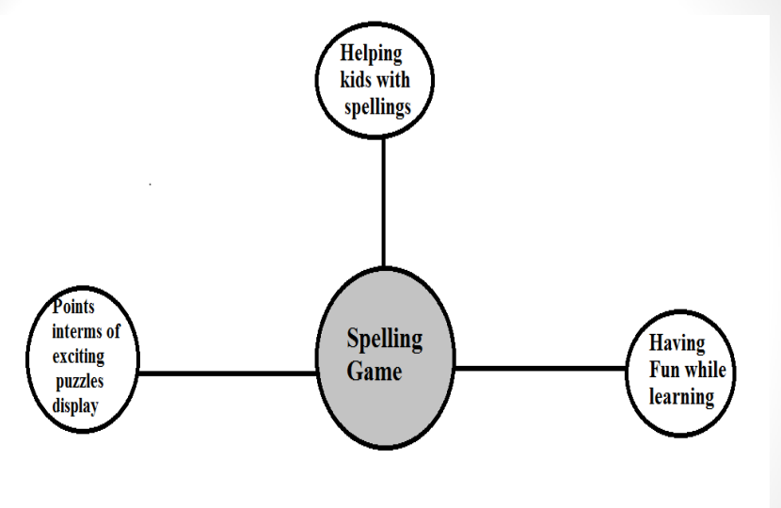

Slide 3
Survey
Get more information about people’s respective of problems while teaching spelling to kids
Give a positive idea to reduce the problem of getting bored, distracted or non interest in learning
Get better idea how kids need help with the learning
Get some suggestions what should we include in our website

Slide 4
Our interviewees and finding them
Teachers ( Kindergarten and local school)
Parents
Kids or Children's
We started interviewing the teachers from local school of native by asking them the questions
Later we asked the known peoples who are having the children in kindergarten to 3rd standards
At last we interviewed the kids.

Slide 5
Teachers
How do you approach kids while teaching them the words and spelling?
How do they react or act while learning by your approach?
What do you think about their performance with fun activity in learning?
How is their performance by learning with fun activity?
Your suggestion to attract attention of kids?

Slide 6
Highlights
Usually teaching by reciting the spelling and words. Giving the home work to practice the spelling and words. By showing them the pictures
Usually takes long time to learn. Either easily get bored or gets non-interested sometimes
Gets excited and its easy to teach and learn. Its easy to remember as the state of mind is free and remembering will be easier.
Active, happy and excited. Remembers more than regular class.
Fun,colorful pics, points, appreciation.

Slide 7
Parents
How kids react while learning at home?
How do you approach kids to teach?
How well do they perform ?
What do you think about fun interactive games to help them?
What is their performance and reaction?
Your suggestion to attract attention of kids?

Slide 8
Highlights
Usually teaching by reciting the spelling and words. Helping them with home work.
Usually make them write the spelling. Making them memorize the spelling of the words.
Difficulty in memorizing. Easily get bored and noninterested.
Games might help them with learning. It will be easy to teach.
Excited to learn, easily remember the words and spellings, much easy to teach.
Vibrant and funny interface , appreciation.

Slide 9
Kids
How do you feel while learning the spelling?
How much you do get the way of approach teaching for your teacher?
How do you feel by learning with fun games?
Which is better way to remember( By the approach of teacher or by games with teaching)?
What would you like to see in games?

Slide 10
Highlights
Sometimes get bores or distracted. Sometimes feel noninterested.
Sometimes it is difficult to understand or memorize. Sometimes it would be stressful to remember.
Would be interesting and fun to learn and play. Would be easy to remember, memorize, identify the words and spelling.
It would be easy to learn, and not difficult to get the concepts.
Like colors, images

Slide 11
Two Empathy Maps:
1.Teacher and Parent
2. Kids

Slide 12
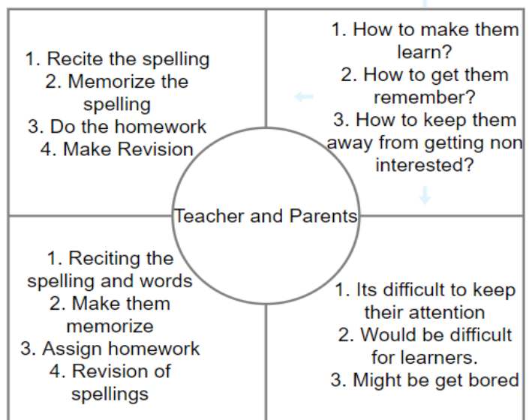

Slide 13
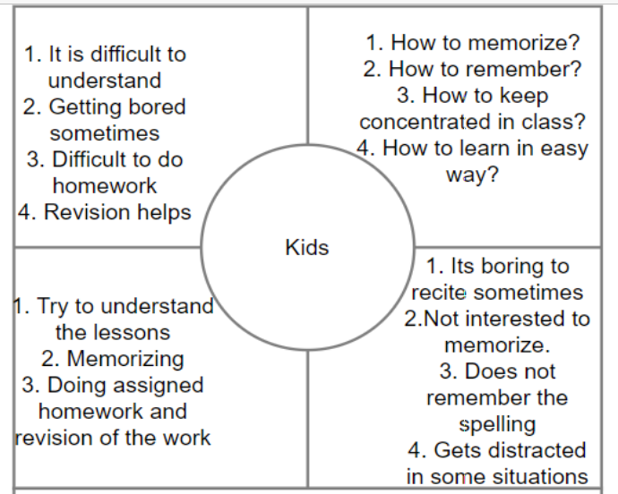

Slide 14
Inferences
Usually keeping the kids concentrated is difficult
Keeping their interest is not easy
Need newer ways need to be implemented to make teaching easy and encourage the kids.
Keeping interactive and enjoyable methods that helps the kids active and to learn and remember the spelling.

Slide 15
Summary
Needs a new ideas to teach the kids with interactive platform.
Needs Stress free, less difficulty learning ways.
It is difficult for teacher and parents to teach children in traditional ways as the children tend to get distracted or noninterested
It will be helpful if we implement the new game as children love to play, it would be helpful to learn .
Providing a interface for learning would help teacher, parents and children to overcome the difficulties

